Slide 1
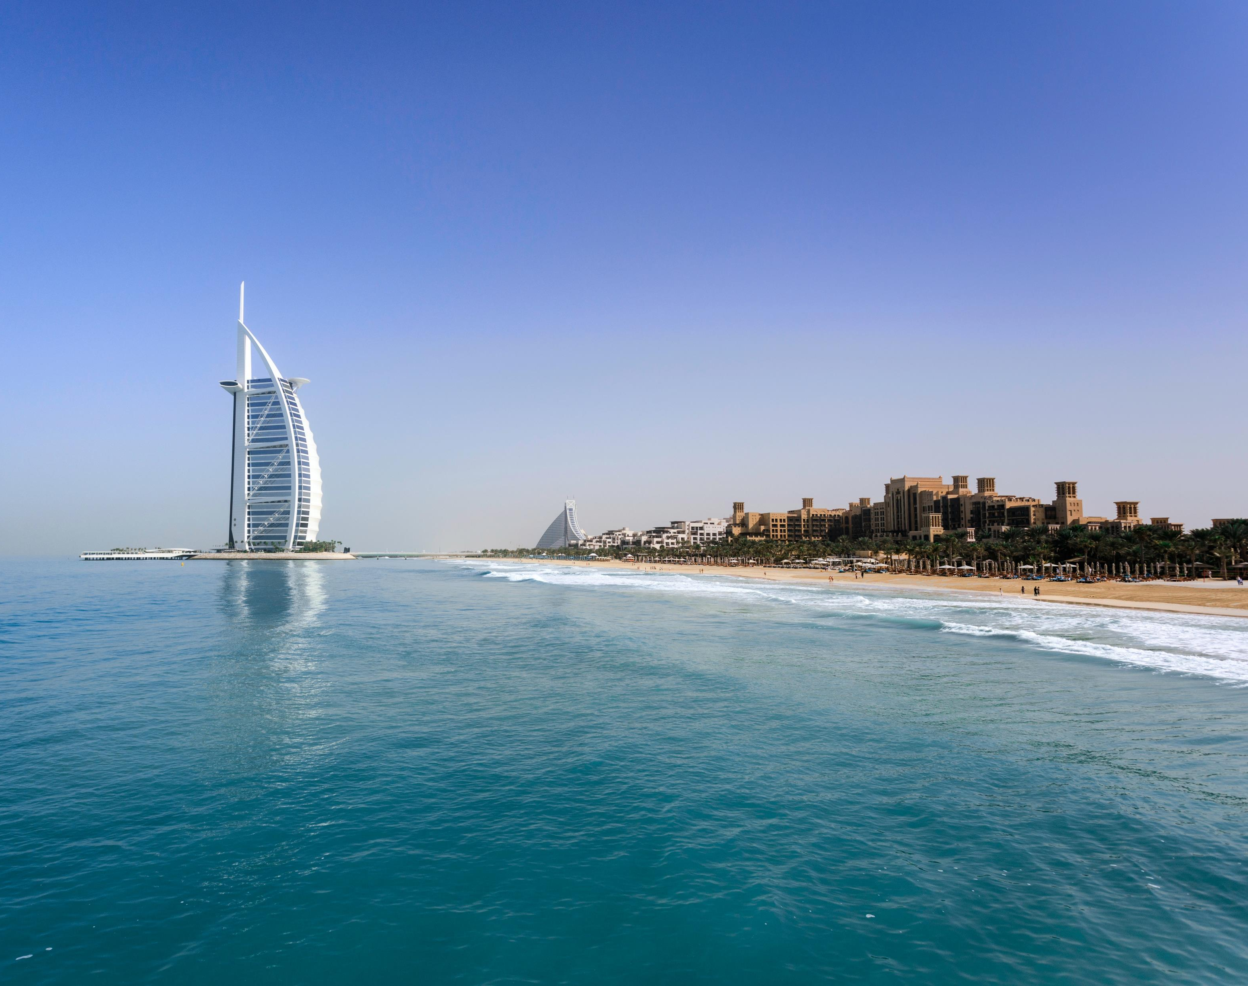
Dubai Tourist Arrivals Case Study
Artefact

Slide 2
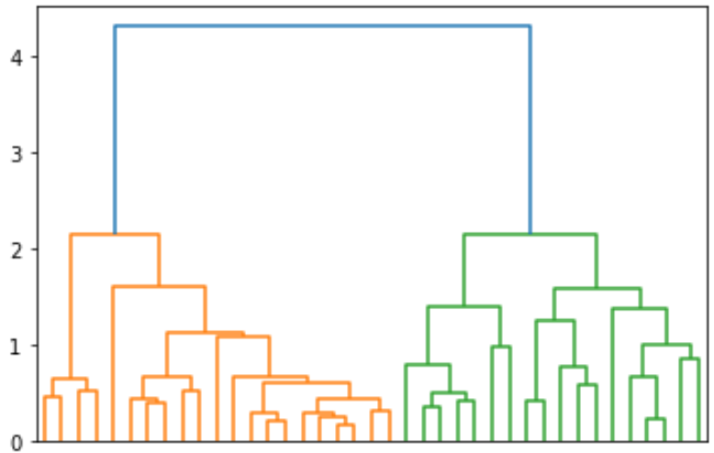
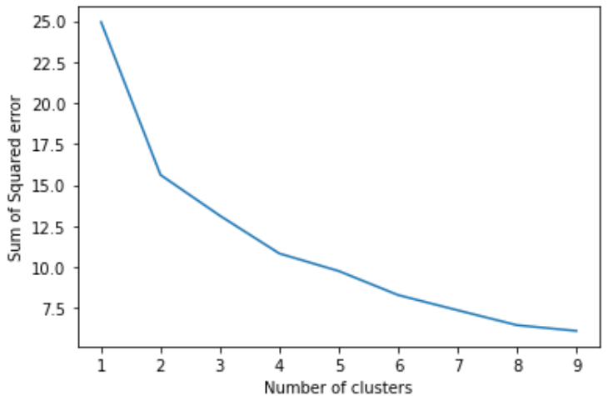
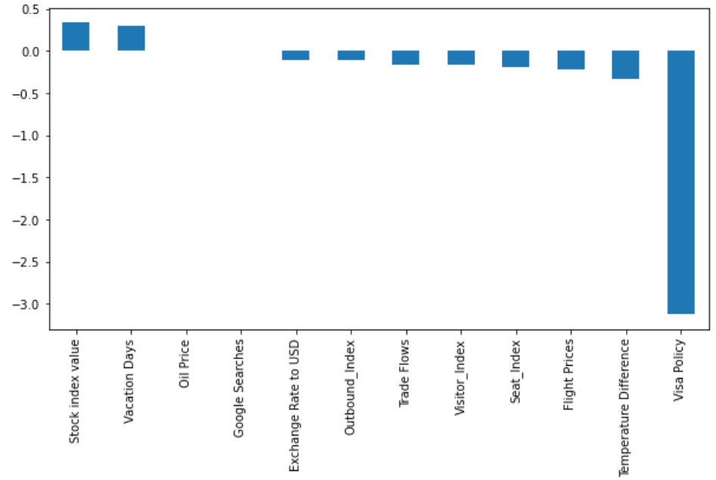
Segmentation
To find optimal number of segmentation both a dendrogram and the internal change in variance were considered.
Both suggested that two groups was the optimal number.
K-Means algorithm with three clusters applied to data.
logistic regression model trained on data with cluster as dependent variable shows which features are most important when segmenting customers.

Slide 3
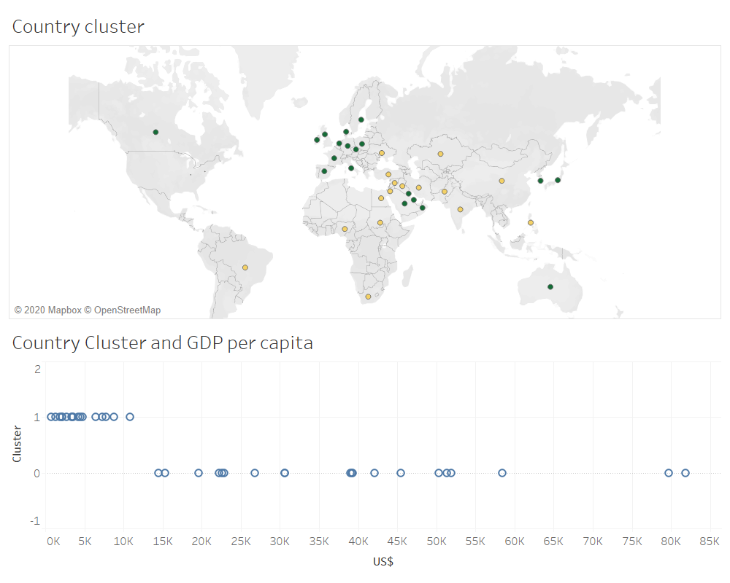
Clustering analysis
Countries in cluster 0 are first world
Countries with higher GDP.

Slide 4
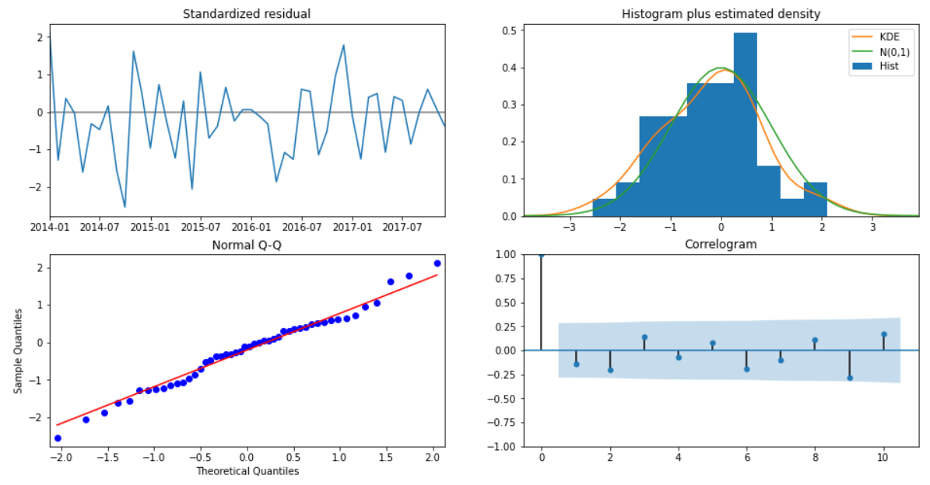
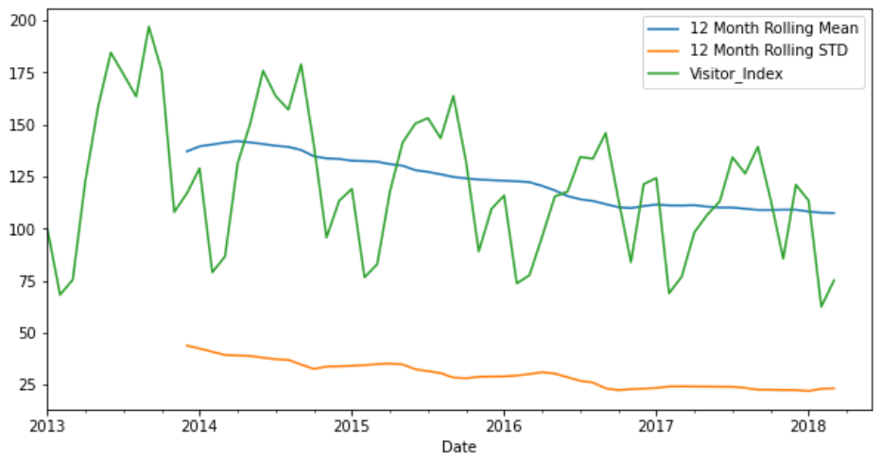
Forecast Visitor Index
Visitor Index is highly seasonal
with repeating patters making the
seasonal ARIMA a good choice.
Example: Australia Visitor Index

Slide 5
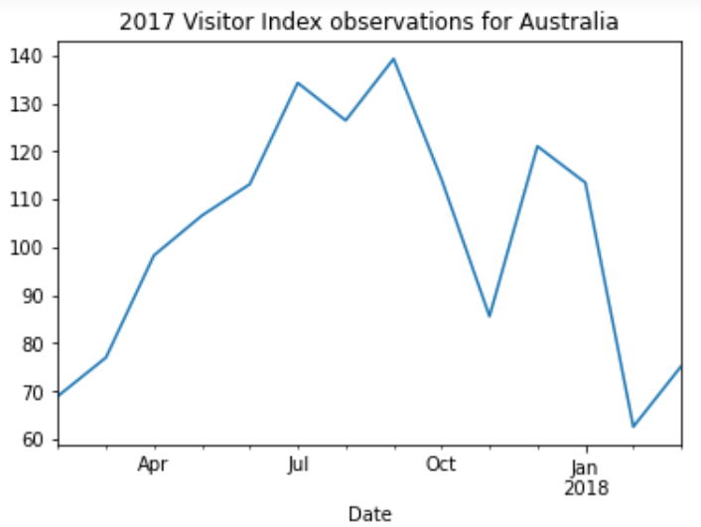
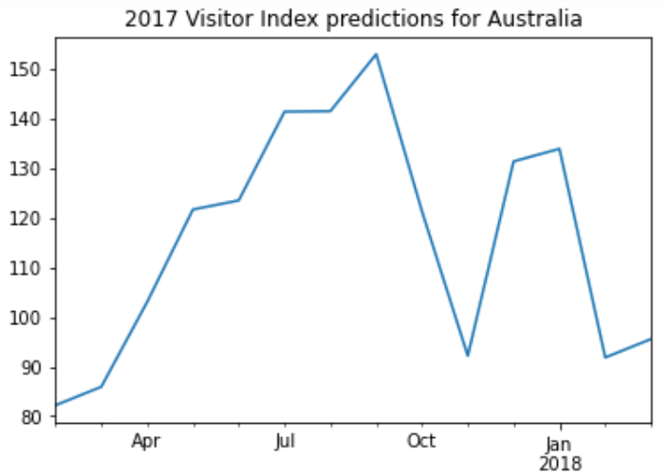
Results
When projected over 2017 the prediction for Australia closely follows the observed values with a MSE of 113.42.
The during testing MSE was similarly close for the remining counties with a median error of 137

Slide 6
Forecasting Using Machine learning
The trend in some of the Visitor Index columns were unable to be stabilized through differencing
machine leaning model was used to predict for countries which either the trend could not be removed or the prediction on the testing data fell outside the 95% confidence interval.
An iterative imputer was used to find the missing values within the data set so that other variables could be used as independent variables.

Slide 7
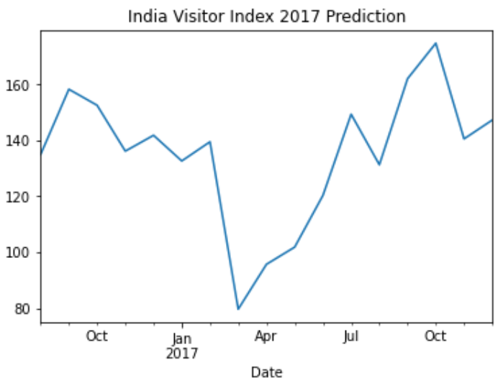
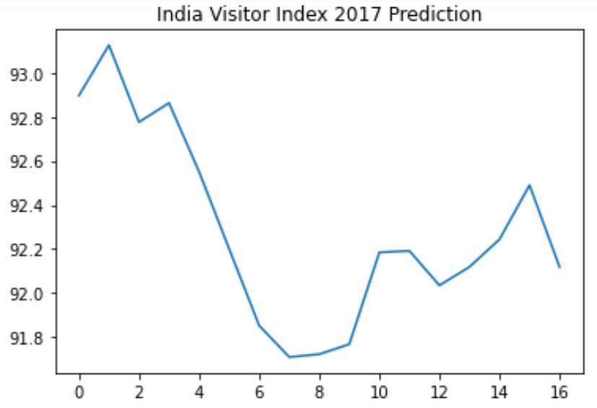
Results of SVM
An SVM model was chosen as it performs well on small data sets.
As can be seen from the example with the Indian prediction, it as able to capture the general trend over 2017.

Slide 8
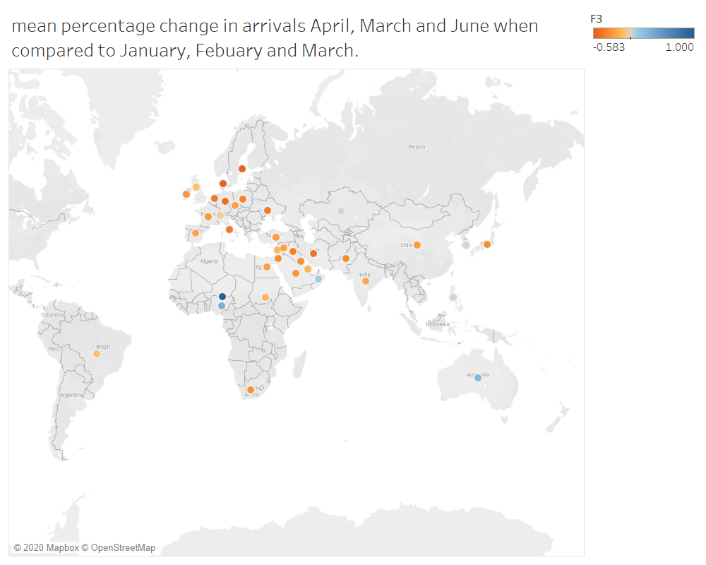
Results

Slide 9
Discussion
Summer sees a generally decline in flights to Dubai as Europeans are less likely to leave and tourists are more likely to go rather to Europe than Dubai.
Australia is an exception, likely due to it being winter in the southern hemisphere.
Advice is to decrease costs over the summer, such as by having a smaller staff in order to preserve profits.

